Slide 1


REAL-TIME, AI-ASSISTED STABILITY ANALYSIS
flame spray pyrolysis
Notes:
Flame pyrolysis introduction
Fourier transform slides?
Acknowledgments

Slide 2
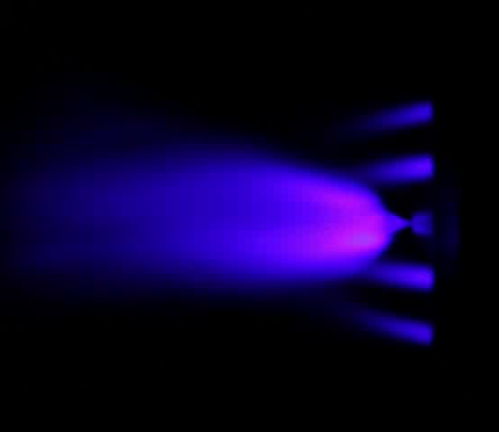
FLAME SPRAY PYROLYSIS
PROBLEM
Synthesis method for nanoparticle production in which sprayed solvent is combusted and powders are formed
Unstable flame conditions mean the results of the synthesis process may be unreliable

Slide 3
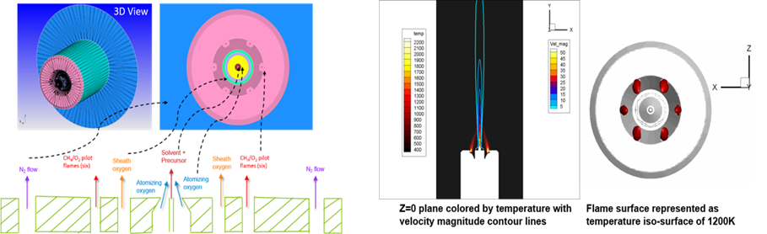
NEW 3D CFD SIMULATION CAPABILITY TO IMPROVE UNDERSTANDING OF FSP AT MERF FACILITY AND GENERATE DATA FOR ML
Schematic of FSP reactor setup
D. Dasgupta et. al, 2019, in preparation
Sample results for pilot flame stabilization

Slide 4
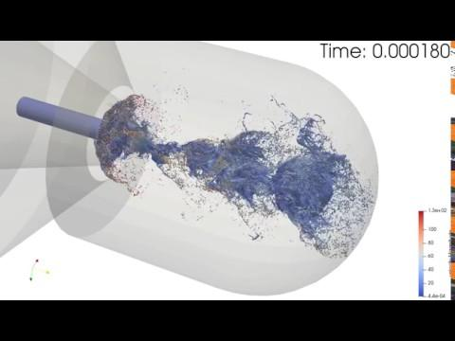
NEW 3D CFD SIMULATION CAPABILITY TO IMPROVE UNDERSTANDING OF FSP AT MERF FACILITY AND GENERATE DATA FOR ML
D. Dasgupta et. al, 2019, in preparation

Slide 5
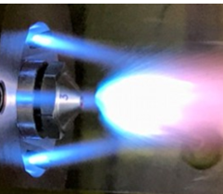

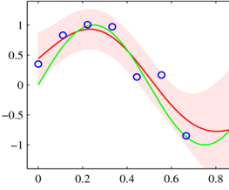
VISION: HUMANS AND SOFTWARE PERFORM A REAL-TIME OPTIMIZATION OF A SYNTHESIS PROCESS
Data Collection
Flame Spray
Pyrolysis
Machine Learning Develops Model
Intelligent Python software drives optimization
Active Learning
M. Stan et. al, 2019, in preparation

Slide 6

Source: Unknown

Slide 7
TIME
RESOURCES
SAFETY
Is $$$
Is also $$$
!($$$ < 0)

Slide 8
TOOLS
Python (OpenCV, Scikit-Learn, Scipy, Numpy, Pandas), Tensorflow, CUDA

Slide 9
METHODOLOGIES
Stability Classification
Unsupervised Machine Learning
Supervised Machine Learning
Notes:
More story-like

Slide 10
STABILITY CLASSIFICATION
1
Objective: quantitatively determine flame stability using video features
Compare measurements ot expert accounts to determine best means of quantifying stable vs. unstable flames

Slide 11

Example #1
Stable Flame

Slide 12
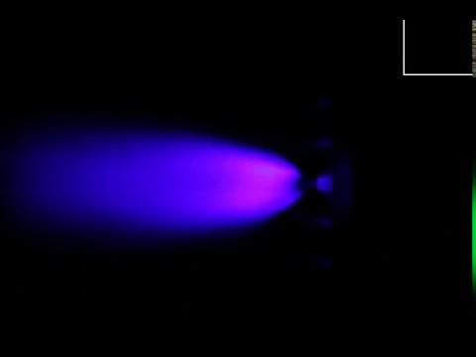
Example #2
Unstable Flame

Slide 13
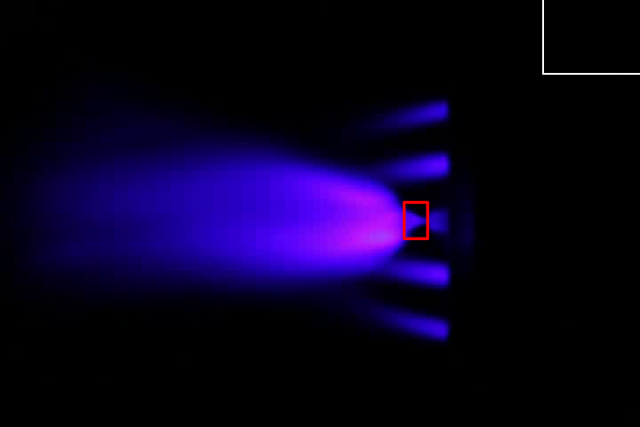
Stability Indicator #1
Bounding Box

Slide 14
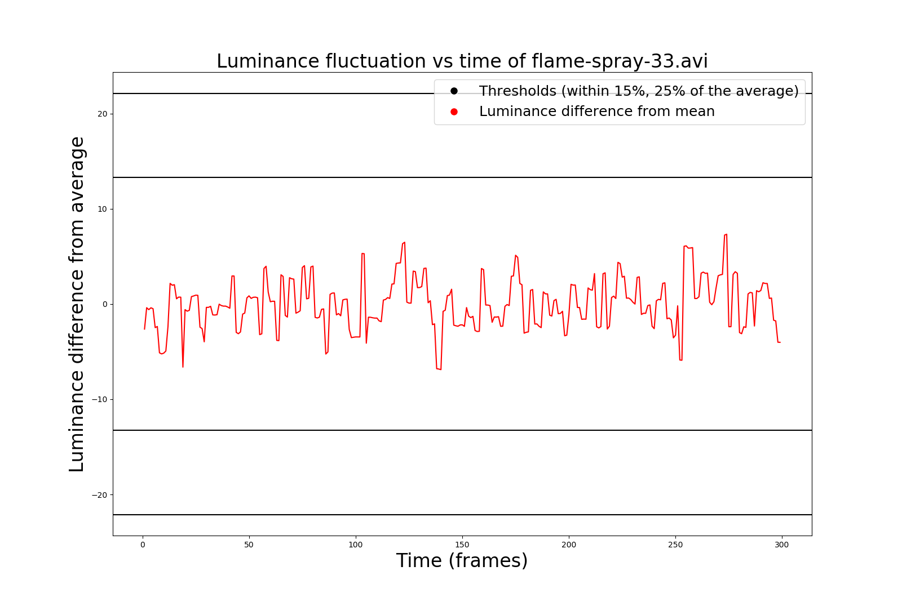
stable

Slide 15
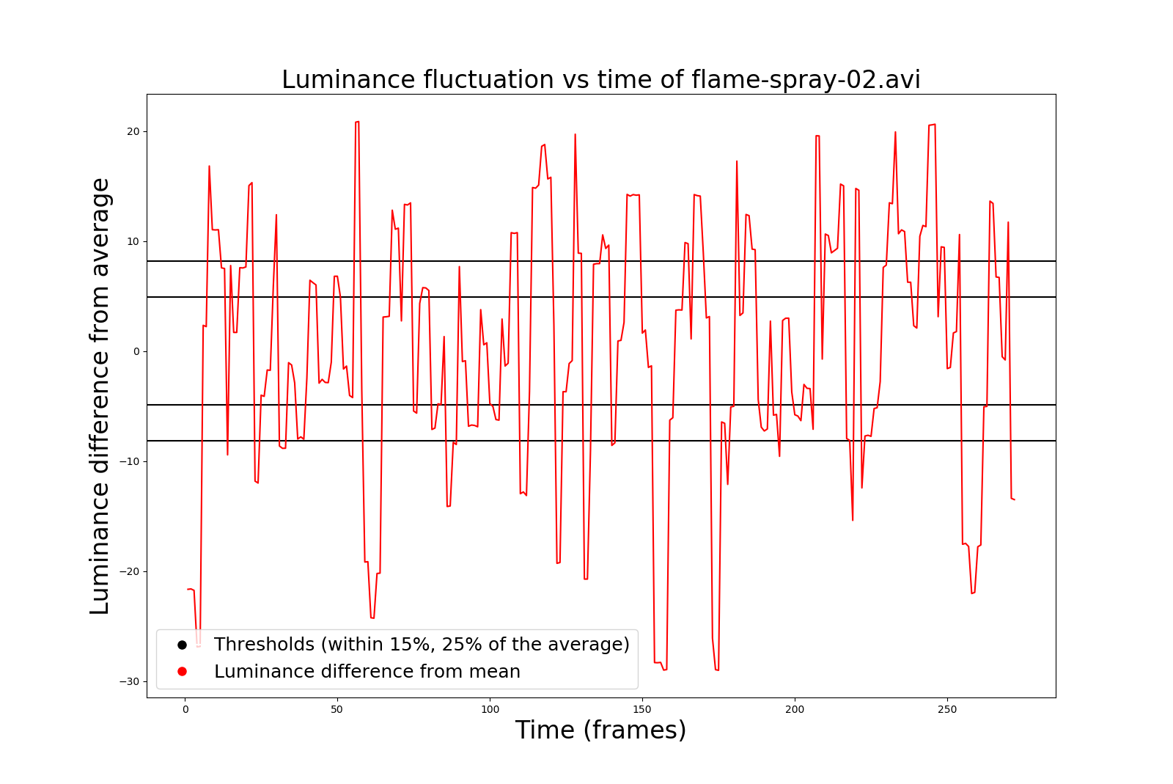
unstable

Slide 16
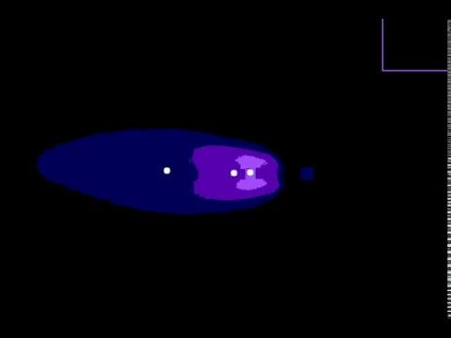
Stability Indicator #2
Centroid Analysis

Slide 17
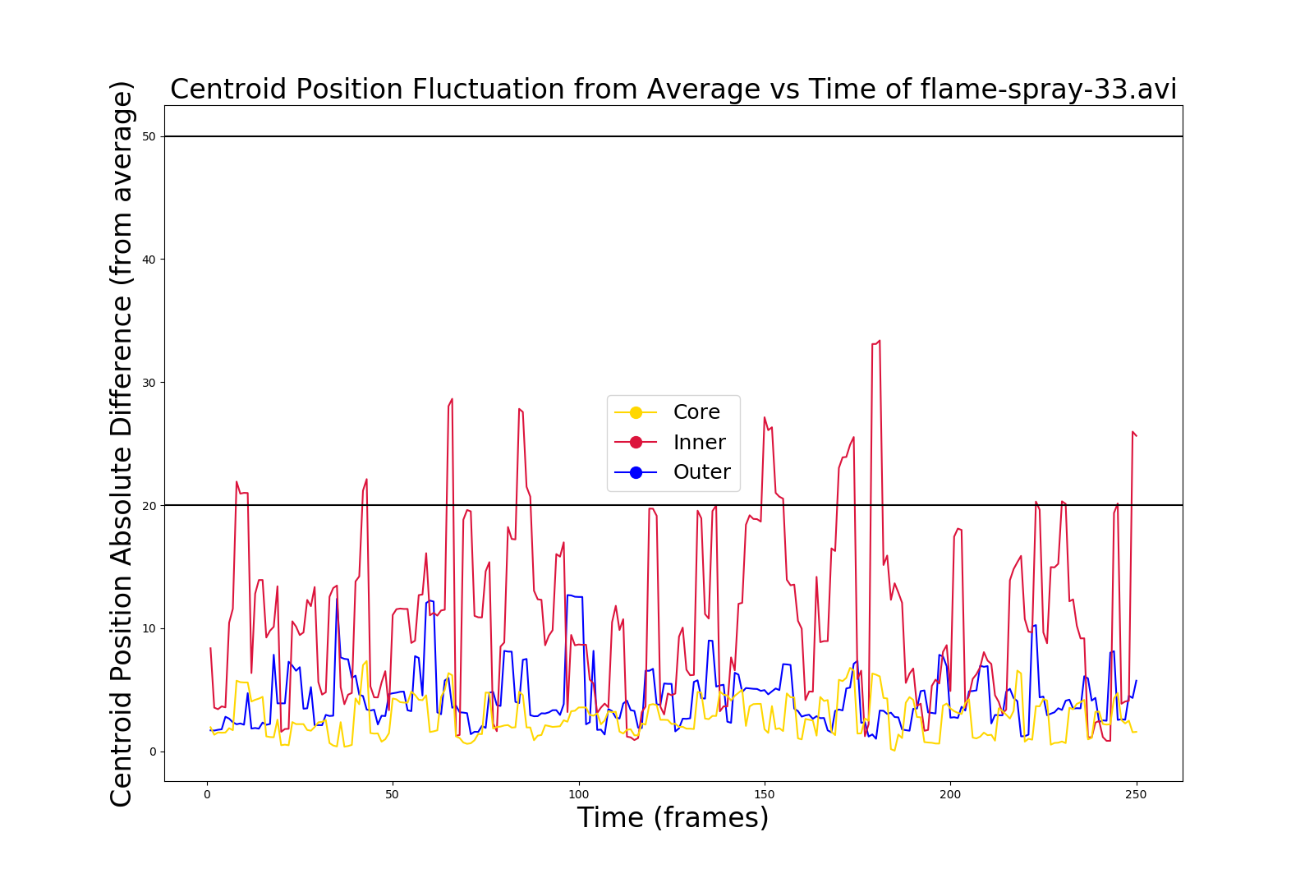
stable

Slide 18
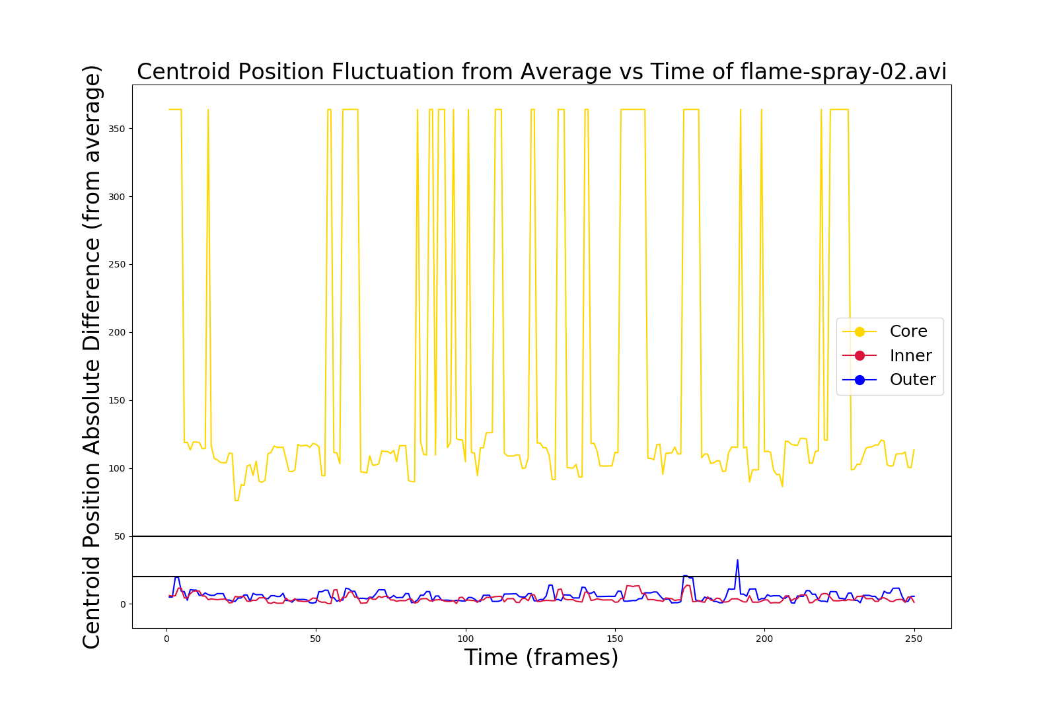
unstable

Slide 19
COMPARISON OF RESULTS WITH EXPERT OPINIONS
Jessica
Debolina
Dante
Joe

Slide 20
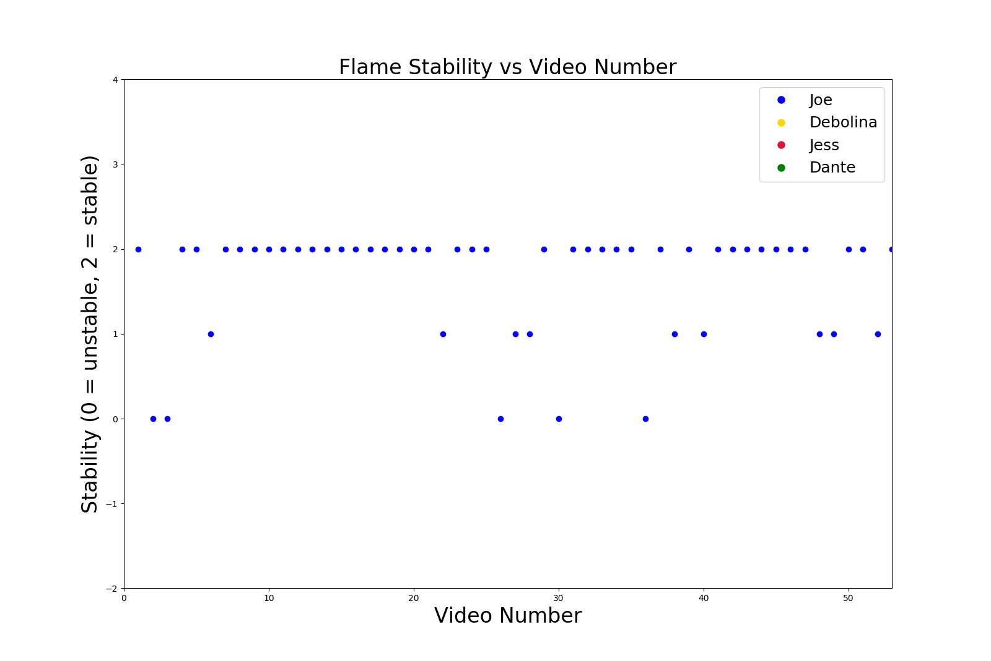
experts
Notes:
Plot hard to understand -- markers instead of lines, narrower, transparency for the markers, add expert opinions one at a time

Slide 21
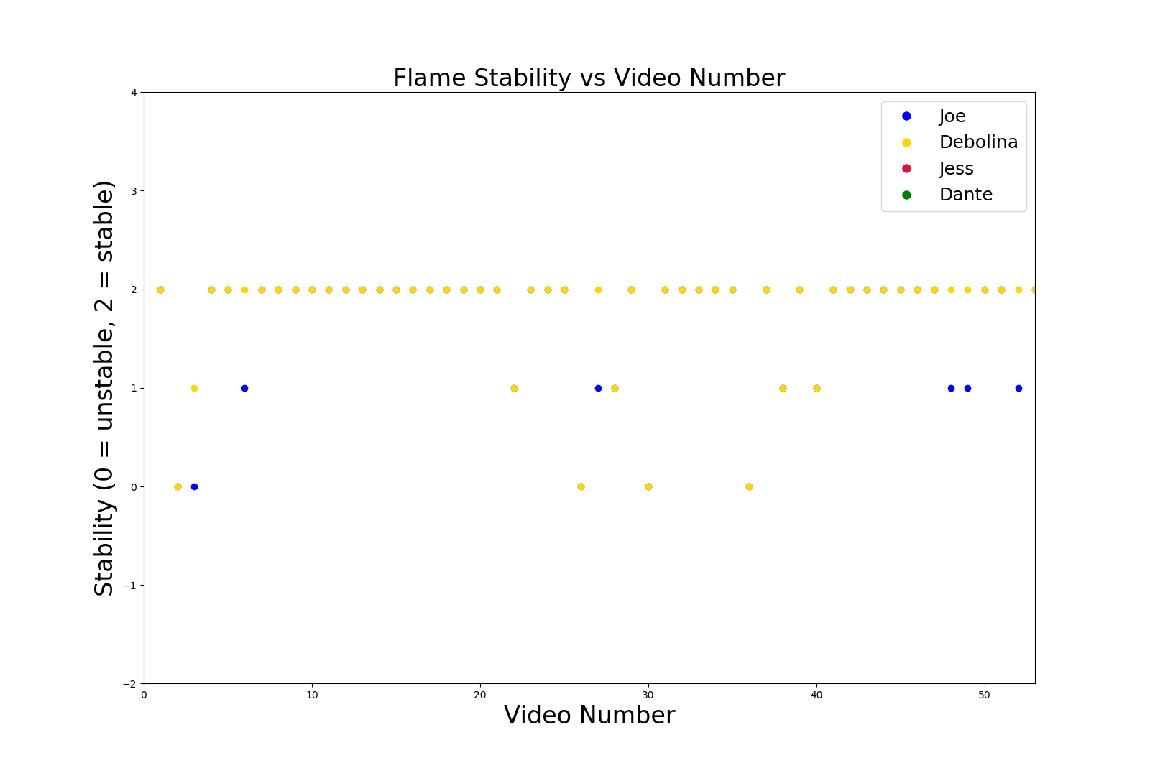
experts
Notes:
Plot hard to understand -- markers instead of lines, narrower, transparency for the markers, add expert opinions one at a time

Slide 22
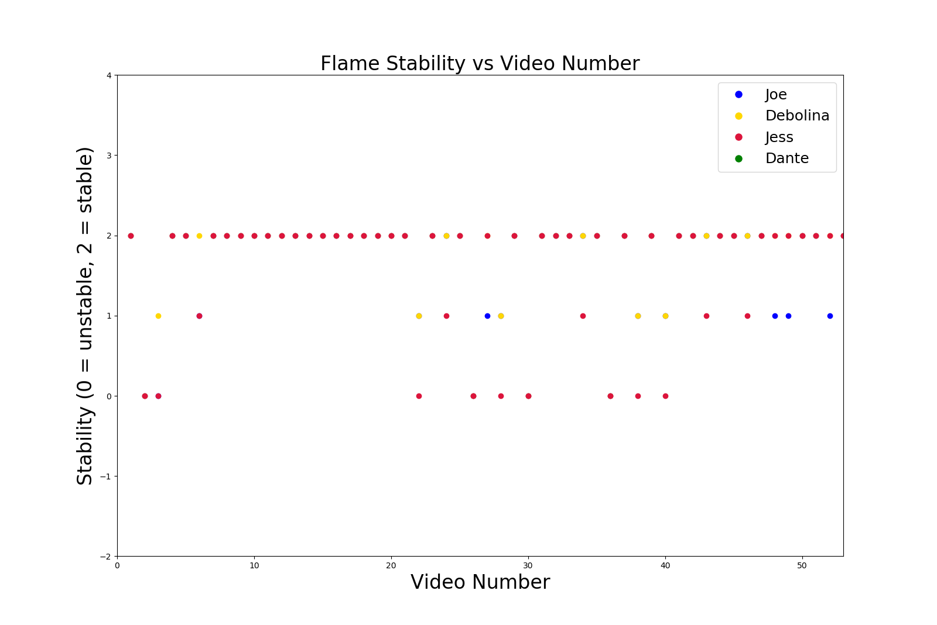
experts
Notes:
Plot hard to understand -- markers instead of lines, narrower, transparency for the markers, add expert opinions one at a time

Slide 23
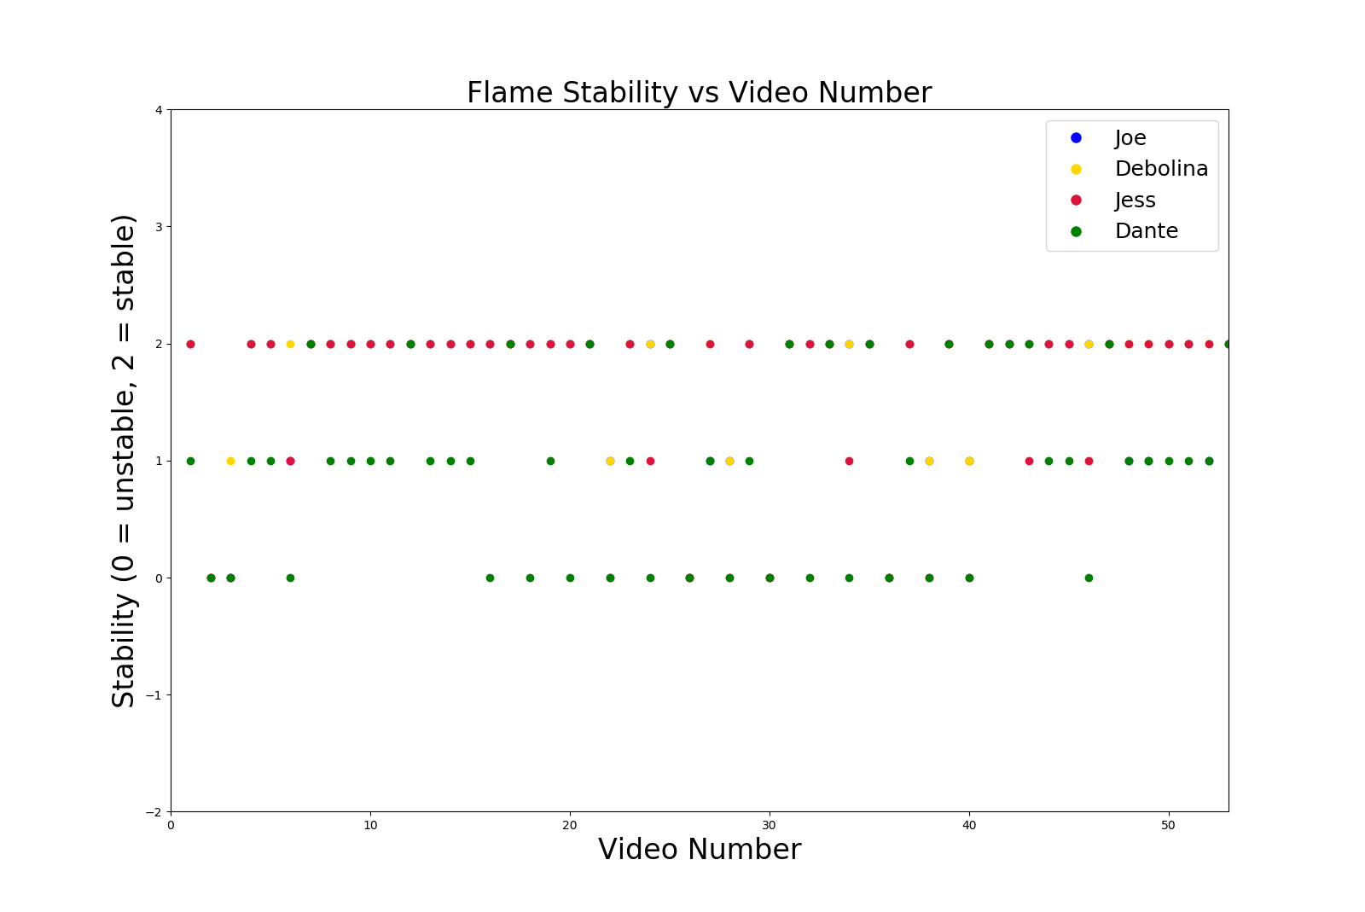
experts
Notes:
Plot hard to understand -- markers instead of lines, narrower, transparency for the markers, add expert opinions one at a time

Slide 24
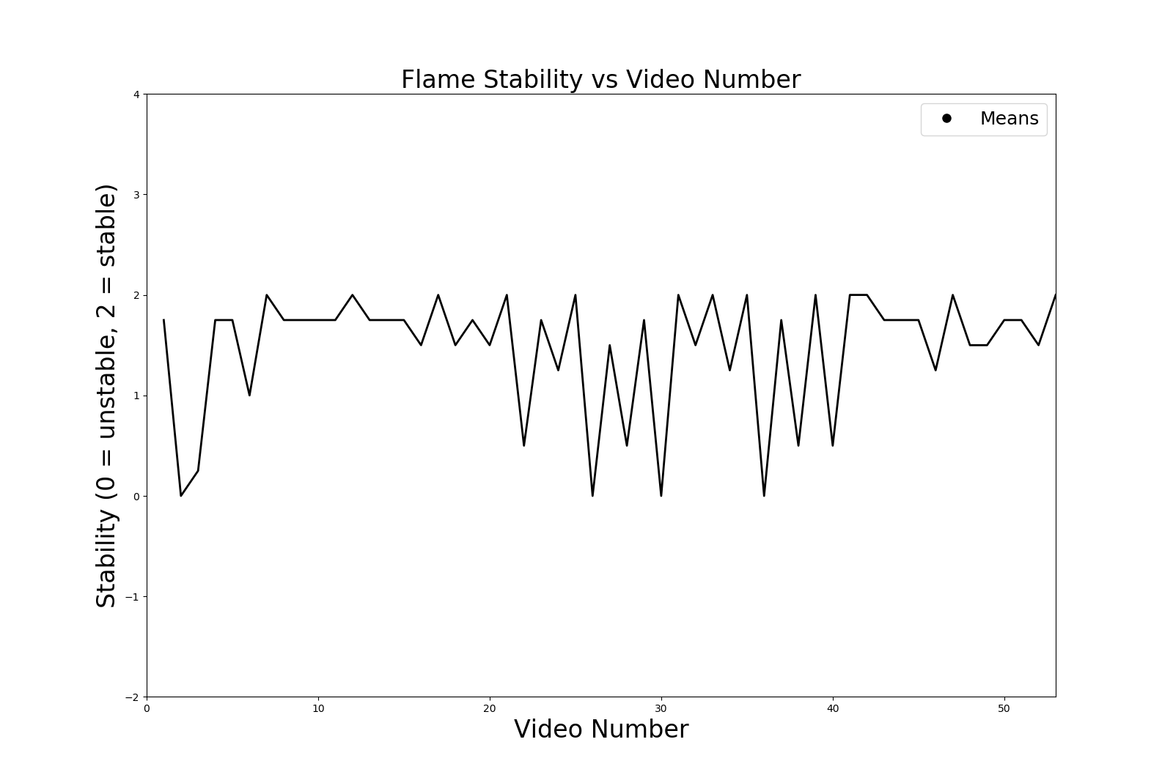
experts

Slide 25
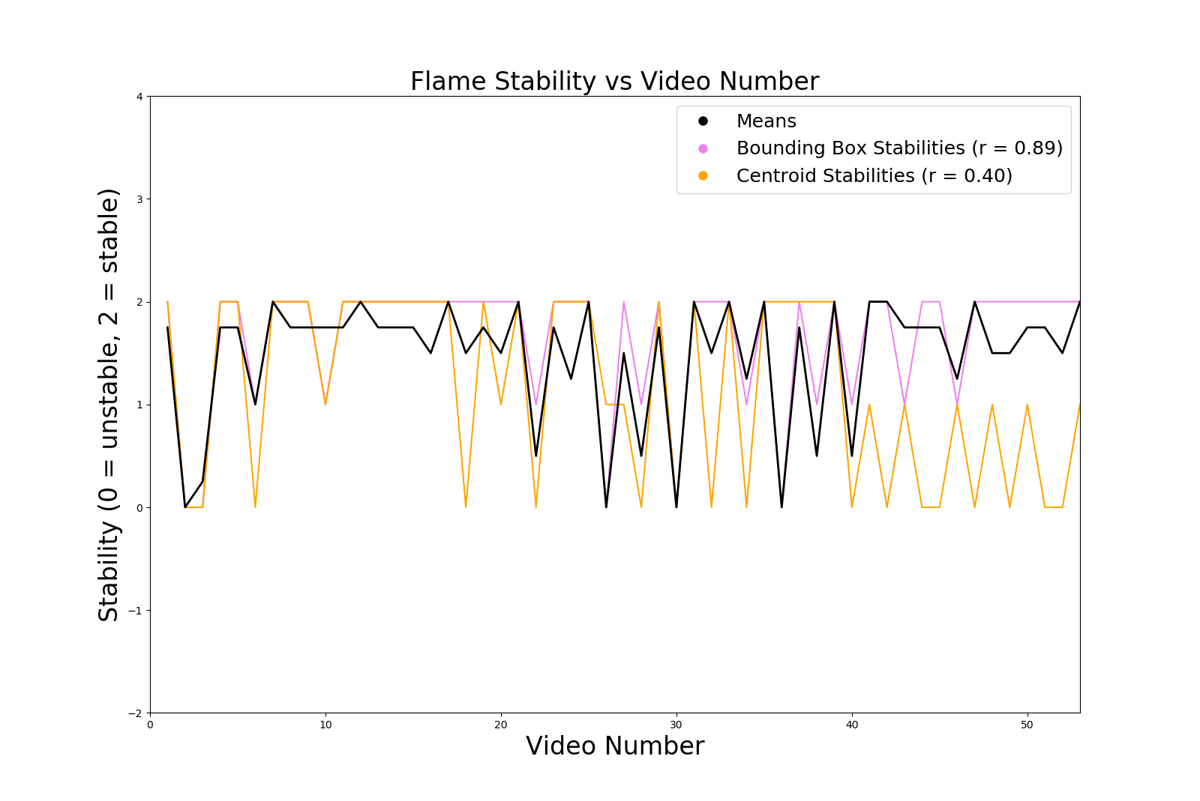
experts

Slide 26
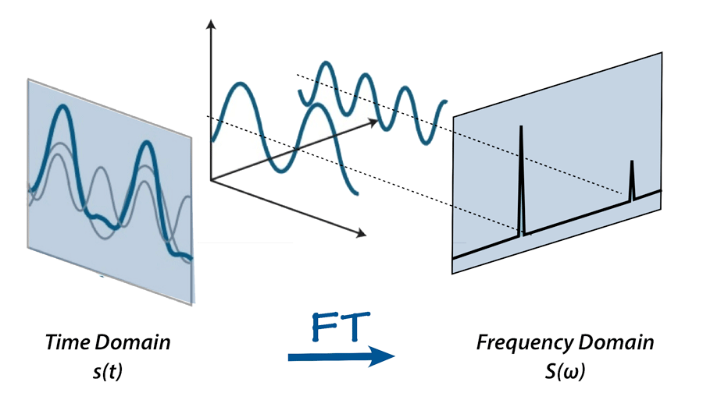
Fourier Transform
http://mriquestions.com/fourier-transform-ft.html

Slide 27
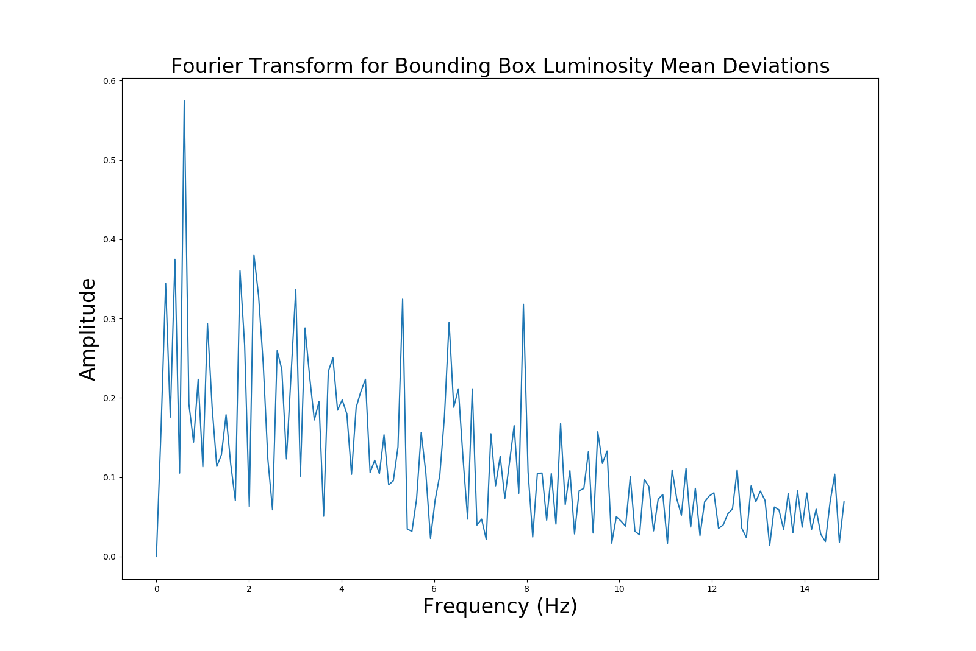
fourier
Notes:
Plot as histogram (may leave out or mention very briefly) -- LABEL CORRECTLY!

Slide 28
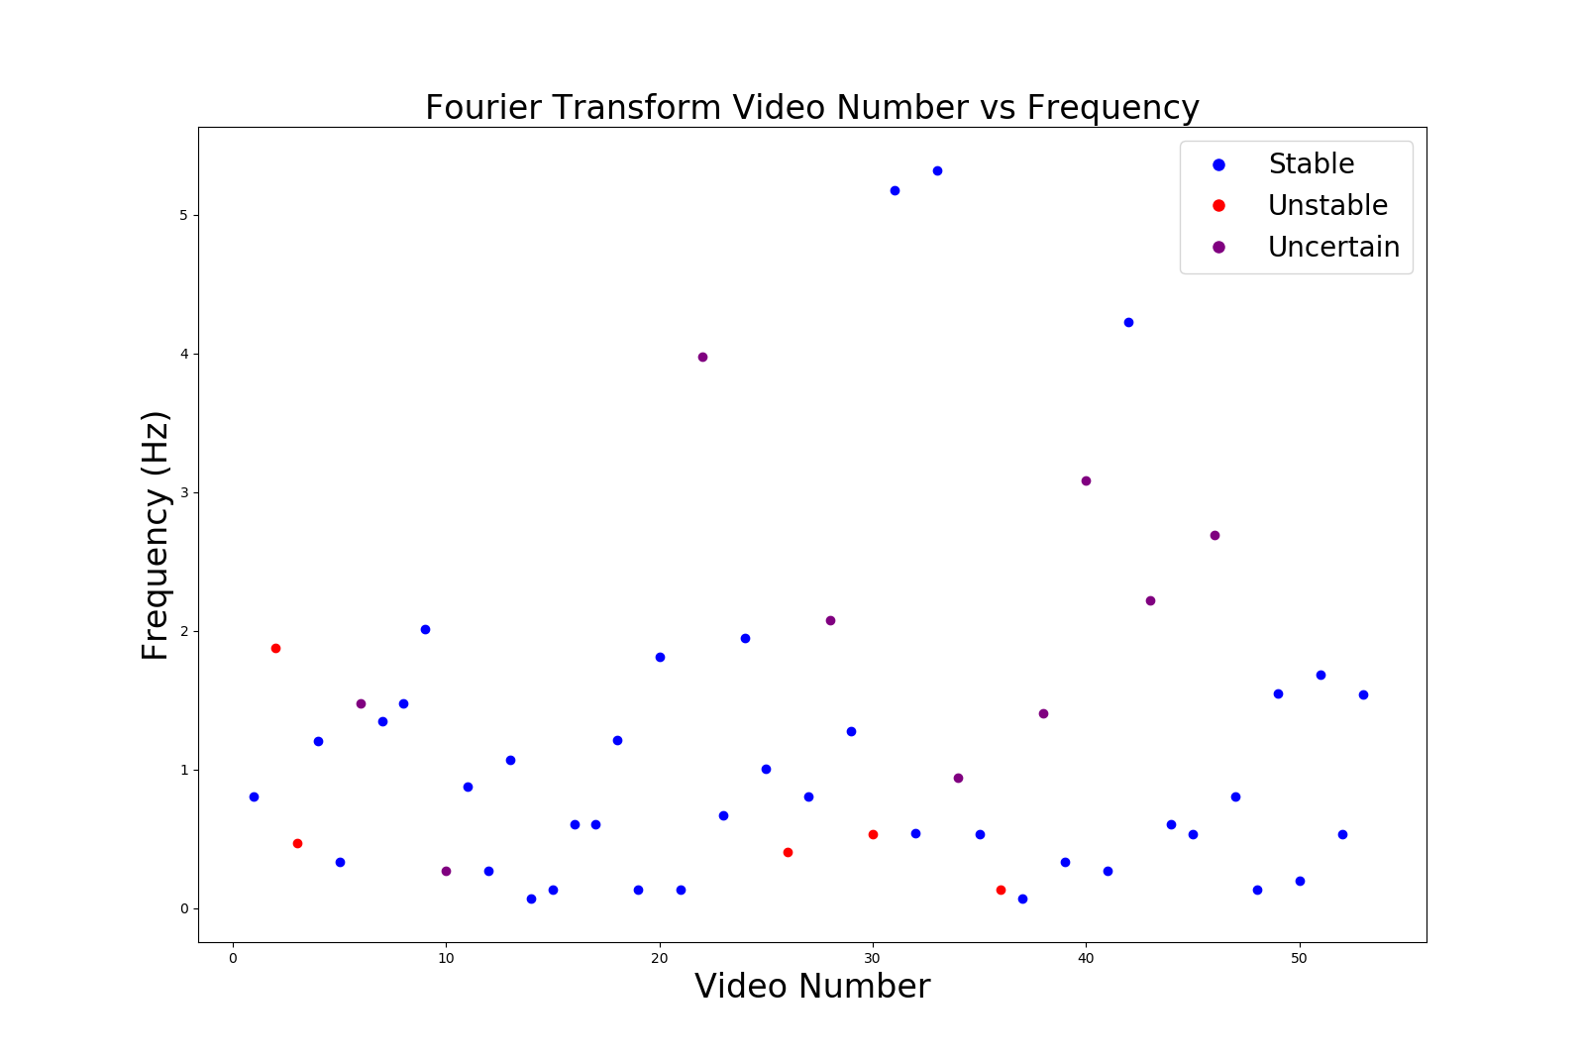
fourier
Notes:
Plot as histogram (may leave out or mention very briefly) -- LABEL CORRECTLY!

Slide 29
UNSUPERVISED MACHINE LEARNING
2
Objective: to see if an algorithm can learn (by itself) the difference between a stable and unstable flame
Principal component analysis on a number of inputs / features

Slide 30
Principal Component Analysis
Dimensionality Reduction Technique
Lots of features
Find orthogonal directions in the data that explain a maximum amount of variance
Fewer features

Slide 31
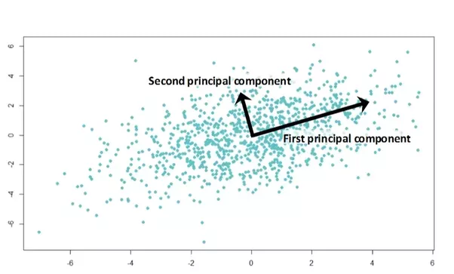
Principal Component Analysis
https://medium.com/@sadatnazrul/the-dos-and-donts-of-principal-component-analysis-7c2e9dc8cc48

Slide 32
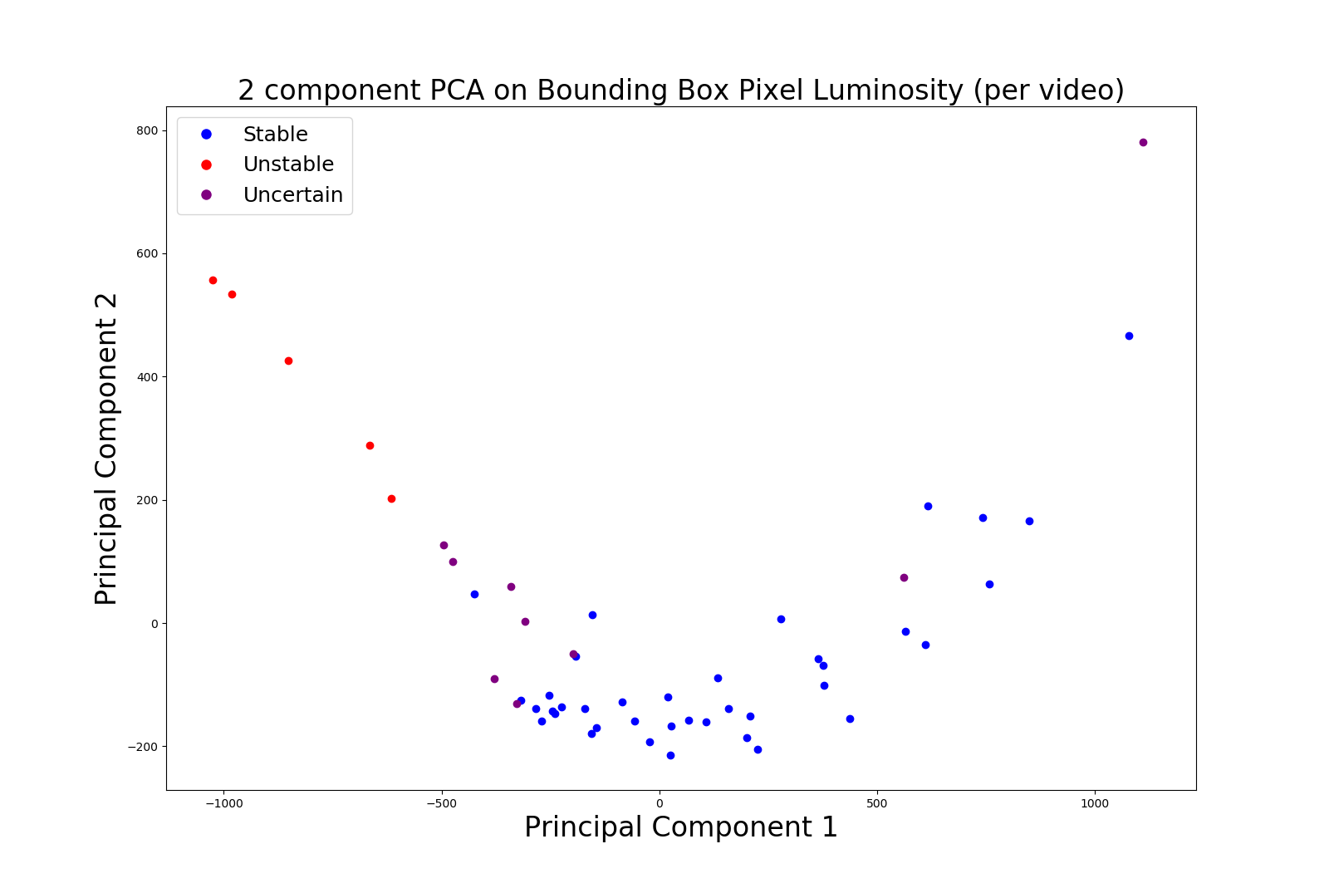
Explained variance: 61%, 13%
PCA

Slide 33
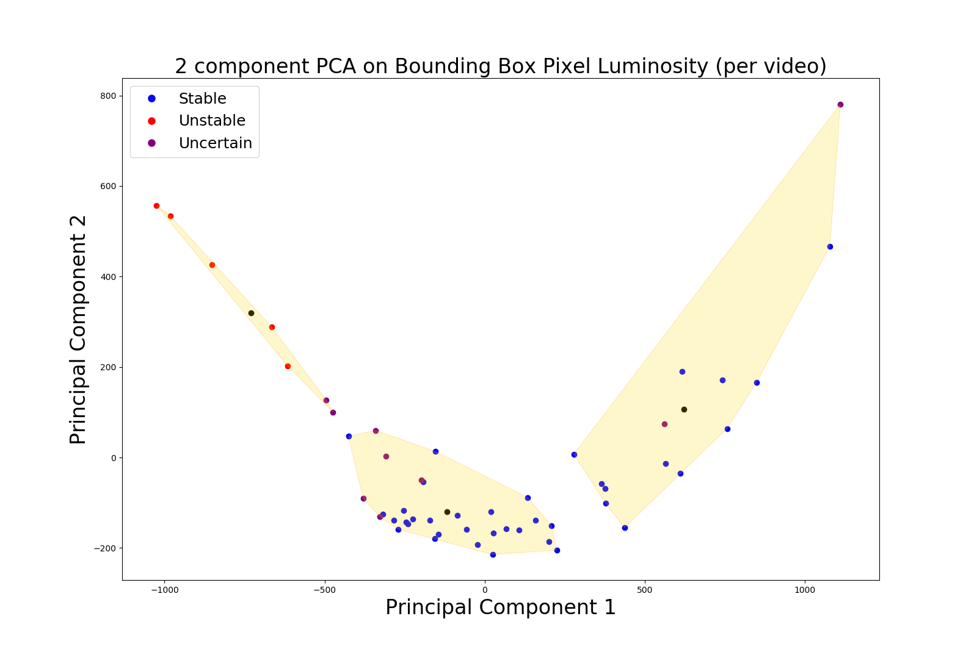
Explained variance: 61%, 13%
PCA

Slide 34
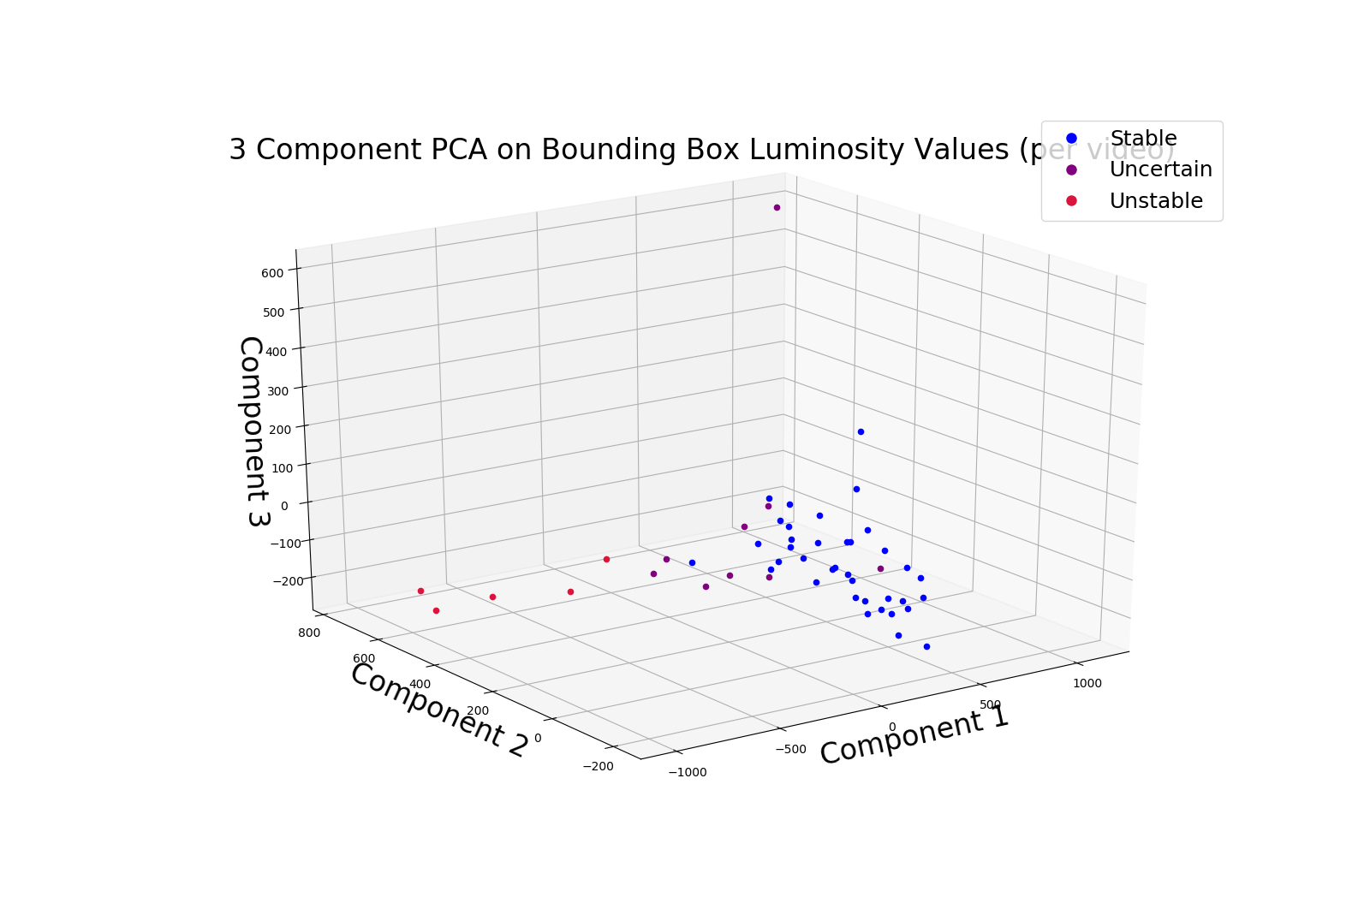
PCA
Explained variance: 61%, 13%, 6%

Slide 35
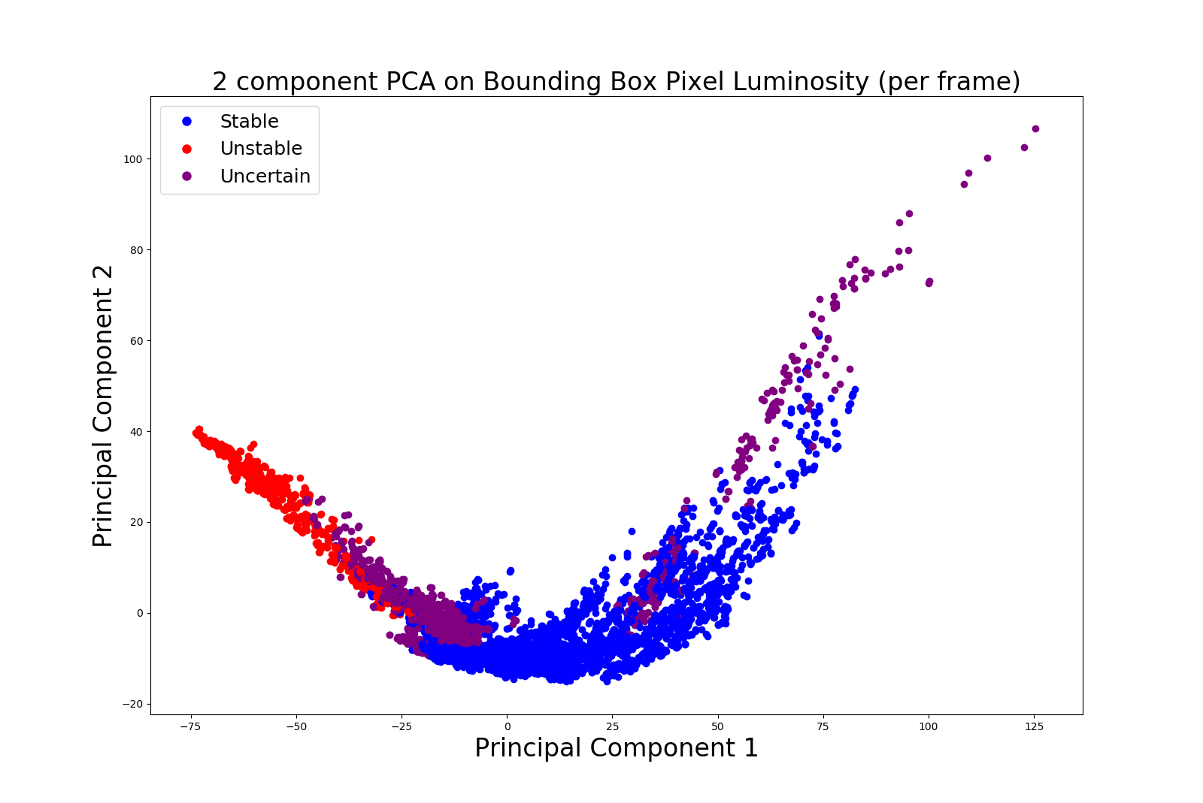
Explained variance: 61%, 14%
PCA

Slide 36
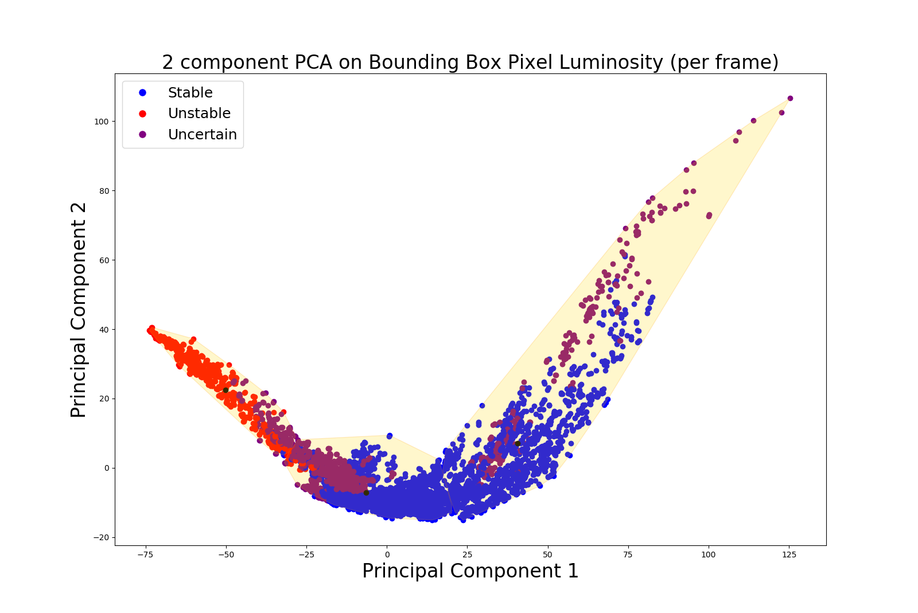
Explained variance: 61%, 14%
PCA

Slide 37
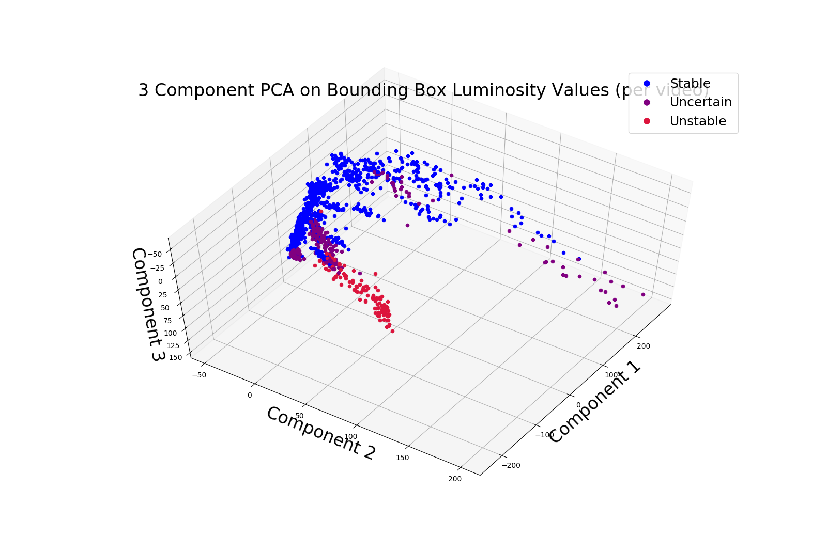
PCA
Explained variance: 61%, 14%, 7%

Slide 38
SUPERVISED MACHINE LEARNING
3
Objective: real-time detection and alert for flame instability
Convolutional neural network data gathering and training

Slide 39
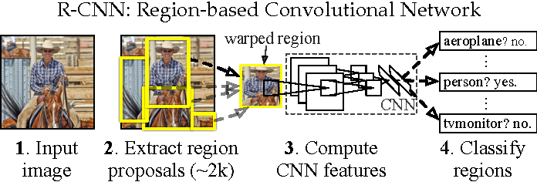
REGION-BASED CONVOLUTIONAL NEURAL NETWORK
Girshick, R.B., Donahue, J., Darrell, T., & Malik, J. (2016). Region-Based Convolutional Networks for Accurate Object Detection and Segmentation. IEEE Transactions on Pattern Analysis and Machine Intelligence, 38, 142-158.

Slide 40
Training/Test Set: ~570 images incrementally picked from video clips
Number of classes: 4
Pilot flame
Stable [flame]
Unstable [flame]
Burner Cap
Training time: ~13 hours
https://github.com/EdjeElectronics/TensorFlow-Object-Detection-API-Tutorial-Train-Multiple-Objects-Windows-10

Slide 41
Results
Stable Flame

Slide 42
Results
Unstable Flame

Slide 43
Results
Unstable Flame Warning

Slide 44
Progress Steps
YOLO Object Detection Model
Autonomous Correction with Object Detection Results
Dante’s Research
Notes:
Future of the project
Acknowledgements!!! -- everyone

Slide 45

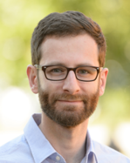


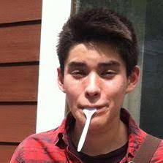
Acknowledgements
Special thanks to everyone who made this experience and research possible:
Marius Stan, Noah Paulson, Dante Gil-Marin, Joe Libera, Debolina Dasgupta, Python, Tensorflow, EdjeElectronics
EERE Robotics Program, ORISE, DOE, Argonne National Laboratory, Lisa Reed, Stephanie Kendzora
Liliana Stan, John Murphy, Young Soo Park
Fellow Argonne Interns :)

Slide 46
THANK YOU!
Stability Classification
Unsupervised Machine Learning
Supervised Machine Learning
Example FSP Videos
Stability Indicator: Bounding Box
Stability Indicator: Centroid Analysis
Expert Comparison
Fourier Transform
Principal Component Analysis Explanation
PCA (per Video)
PCA (per Frame)
RCNN Explanation
Training Method
Results: Stable Flame
Results: Unstable Flame
Unstable Flame Warning

